Slide 1

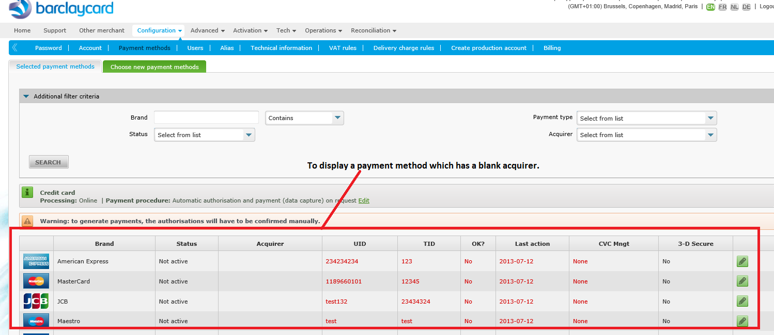

 | Blank Acquirer entry into merchant card table | Stakeholder: Sponsor: | FE: | Complexity:
As an [FE Manager], I want to [Display a payment methods which has a blank acquirer into selected payment methods]

Slide 2
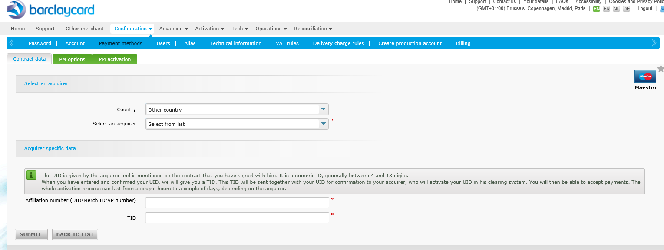
Click on edit button then contract tab will load as like a insert screen and click on submit button will update the data into merchant card table

Slide 3
Acceptance criteria

